Slide 1
REVOLUTIONIZING DIABETES MANAGEMENT USING MACHINE LEARNING
Presented By
MADHUSHRII P V & RITHIKSHARVESH K S
M. Sc Datascience, Vellore Institute Of Technology, Chennai
Under the guidance of
DR. UMAMAHESWARI S
Assistant Professor(Sr), Division of Mathematics, School of Advanced Sciences,
Vellore Institute of Technology, Chennai

Slide 2
BACKGROUND:
Recent years have seen a surge in the popularity of machine learning used in recommendation systems.
In the health sector, recommendation systems are used to offer precise dietary guidance.
AIM:
Our aim is to make a system that helps users to get a proper diet and exercise plan from time to time and help them to create a balance in overall calorie intake throughout the day.
Since these patients must strictly engage in regular physical activity and follow diet plans to control blood sugar levels.

Slide 3
OBJECTIVE:
Diet recommendation system :
Diet will be suggested based on the inputs entered by the user such as Age, Weight, Height, Type of Diabetes, Glucose levels, Insulin usage etc...
Exercise recommendation system :
With a good diet, Proper exercise is also required . Different types of exercises will be suggested according to their age and BMI.

Slide 4
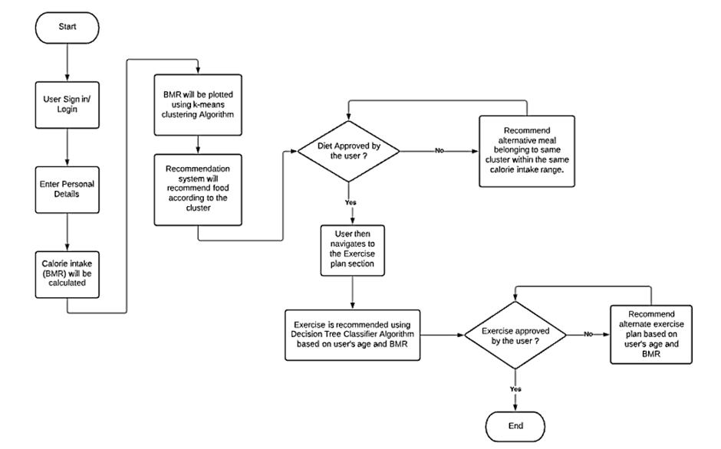
PROPOSED SYSTEM:

Slide 5
METHODOLOGY:
Logistic Regression
Support Vector Machine
K- Nearest Neighbor
Random Forest
Naïve Bayes
Gradient Booster

Slide 6
MODEL EVALUATION METHODS USED
Accuracy Score
ROC AUC Curve
Cross Validation
Confusion Matrix

Slide 7
RESULTS:
We have divided our dataset into two parts using sklearn library from python.
Train part to train our dataset.
Test part to test the model that we have built.
We have used 75% of our total dataset for training our model.
Moreover, 25% of our dataset used for testing and evaluating the result.

Slide 8
EXISTING MODEL:
ALGORITHMS | ACCURACY
SUPPORT VECTOR MACHINE | 64%
NAÏVE BAYES | 68%
DECISION TREE | 96%

Slide 9
MODEL EFFICIENCY:
ALGORITHMS​ | ACCURACY​
LOGISTIC REGRESSION​ | 76%​
SUPPORT VECTOR MACHINE​ | 78%​
K – NEAREST NEIGHBOR​ | 70.6%​
RANDOM FOREST​ | 98.4%​
NAÏVE BAYES​ | 76%​
DECISION TREE | 90%​

Slide 10
CONCLUSION:
An accuracy of 93% for food recommendation and an accuracy of 87.9% for exercise recommendation was achieved for this system.
Accuracy can be improved by adding more data into the system.
The increase in the number of data values will help in the formation of clusters more precisely, thereby improving the accuracy of the system.
The scope of our project can be extended by providing the users with the data of all the clinics nearby so that the user can contact the nearby doctors easily.
The reminder system can also be added, so that the users get notified on a regular basis for checking their glucose levels and consulting the doctor timely.

Slide 11
REFERENCE:
I. J. Eva, S. J. Anika, M. A. Mitu and A. Sattar, "Diabetes Health Care Routine Using Machine Learning," 2022 First International Conference on Electrical, Electronics, Information and Communication Technologies (ICEEICT), Trichy, India, 2022, pp. 1-5, doi: 10.1109/ICEEICT53079.2022.9768659.
Singla R, Singla A, Gupta Y, Kalra S. Artificial Intelligence/Machine Learning in Diabetes Care. Indian J Endocrinol Metab. 2019 Jul-Aug;23(4):495-497. doi: 10.4103/ijem.IJEM_228_19. PMID: 31741913; PMCID: PMC6844177.
F. Almatrooshi, S. Alhammadi, S. A. Salloum, I. Akour and K. Shaalan, "A Recommendation System for Diabetes Detection and Treatment," 2020 International Conference on Communications, Computing, Cybersecurity, and Informatics (CCCI), Sharjah, United Arab Emirates, 2020, pp. 1-6, doi: 10.1109/CCCI49893.2020.9256676.
S. S. Bhat and G. A. Ansari, "Predictions of Diabetes and Diet Recommendation System for Diabetic Patients using Machine Learning Techniques," 2021 2nd International Conference for Emerging Technology (INCET), Belagavi, India, 2021, pp. 1-5, doi: 10.1109/INCET51464.2021.9456365.

Slide 12
THANK YOU

